Slide 1
The Lyallpur Medical Services Trust
LMST
www.lmst.org.pk

Slide 2
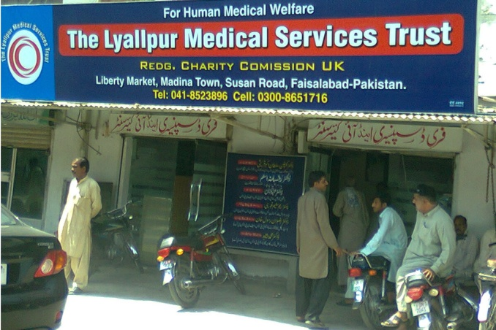
Introduction
LMST
Trust is a free hospital working with a motive to provide free medical and surgical facilities to the deserving patients
Established in 2007 by Dr. Sultan Akbar Qureshi.
Registered with charity commision UK in 2010 Reg. No. 1135183
Registered in 2013 with government Of Punjab Reg. No. RJSC/FSD/1278

Slide 3
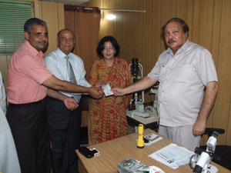
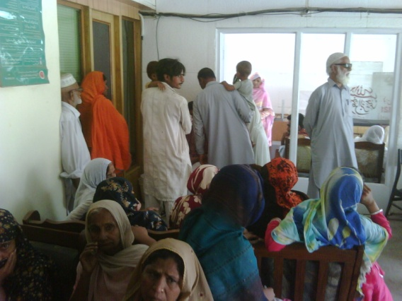
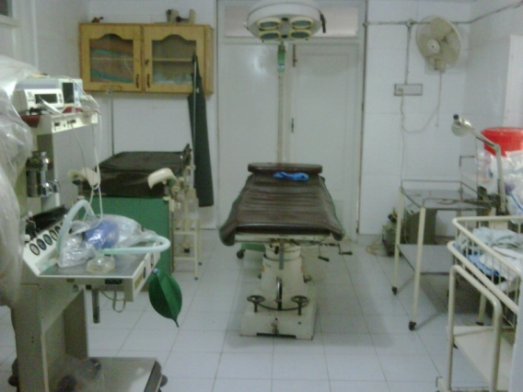
LMST
Achievements
Started off in 2007 at a 400 Sq feet rented property with facility of Eye and Gynae OPD and minor Surgery.
Now in 2018 rented area is increased 30 times due to increased no of patients
ENT and General Surgery OPD and surgical Facility is Added.

Slide 4
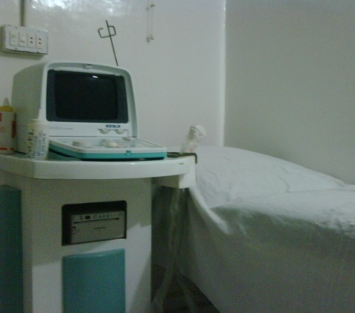
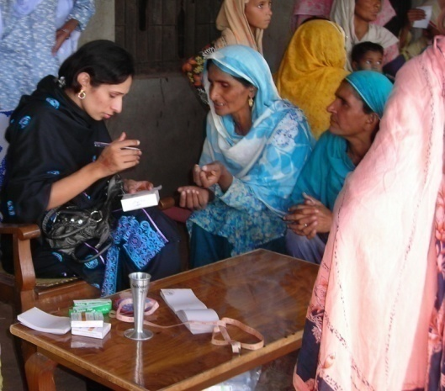
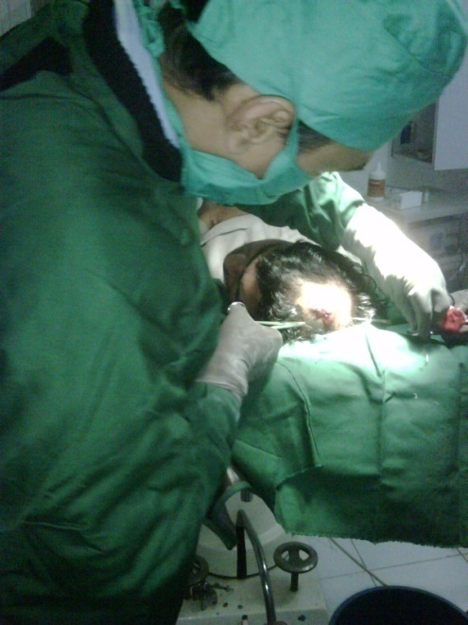
LMST
Achievements
Consultant Gynecologist with Ultrasound and well equipped Labor Room and Operation theater for all types of gynecological surgeries.
Chest and Derma (Skin) Consultation on weekly basis
Medical Officer from 8 am to 8 pm
Free Medicine for all patients
Free Medical Tests for deserving patients.

Slide 5
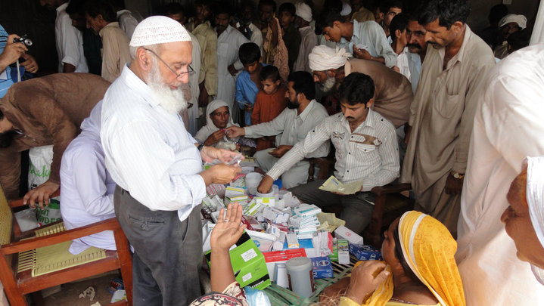
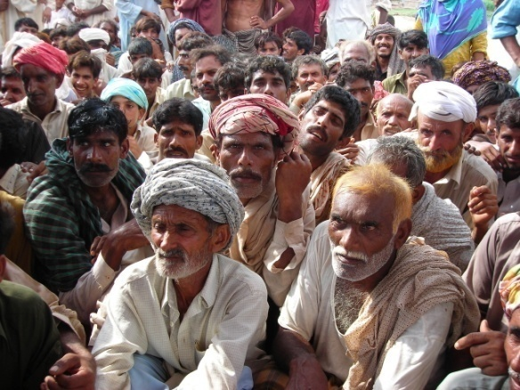
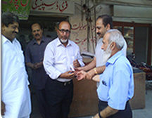
LMST
Achievements
Flood Relief Camp with Doctors, Free Medicine and Food was arranged.
Free Typhoid and paratyphoid vaccination in summer holidays for school children.
Financial Assistance cheque to “Tuam” to provide free food to poor people.

Slide 6
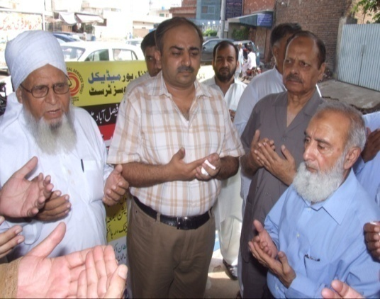
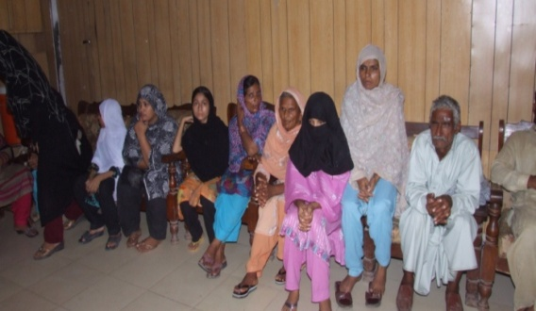
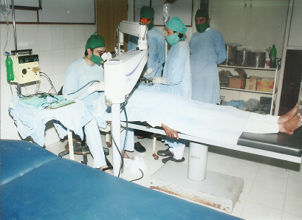
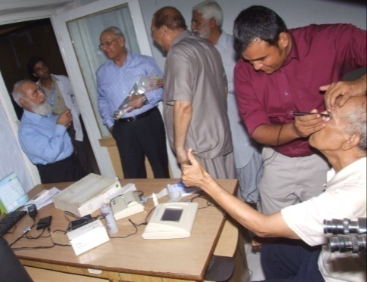
LMST
Achievements
With the help and donation of our trustees and donors
  The trust now own medical instruments worth Rs. 11 million
  Annually Organize a free eye camp for one month since 2010 with free surgery, implant and post operative medicines.
  Now a renowned eye hospital of the city.

Slide 7
No of free consultations per year
LMST
Patients | Year
18708 | 2007
22315 | 2008
27430 | 2009
33531 | 2010
36503 | 2011
38733 | 2012
42537 | 2013
46138 | 2014
50096 | 2015

Slide 8
No. of Free Surgeries Per Year
LMST
Surgery | Year
45 | 2007
175 | 2008
230 | 2009
340 | 2010
437 | 2011
527 | 2012
678 | 2013
778 | 2014
1050 | 2015
1250 | 2016
1450 | 2017

Slide 9
BUDGET
LMST
Year | Budget
2007 | 275000
2008 | 586000
2009 | 1170000
2010 | 1588000
2011 | 2243000
2012 | 3628500
2013 | 4713750
2014 | 6231892
2015 | 7250000
2016 | 7550000
2017 | 8550000

Slide 10
Panel Of Trustees
LMST
Mian habib-ul-Islam (Chairman) 190 Brantingham road, Chorlton cum hardy Manchester | Mian Sala-ud-Din (President)
(Vice President) Mian Shuja-ud-Din Nasim Ullah Chohan | General Secretary Capt .( R ) Dr. Sultan Akbar Qureshi
Joint Secretary Dr. Hassan Raza Qureshi | Finance Secretary Mian Arshad Iqbal
Assistant Finance Secretary Mohammad Ahsan | Press Secretary Mr. Nabeel Ahmed Chohan

Slide 11
Panel Of Consultants
LMST
Daily | Weekly
Dr. Sultan Akbar Qureshi MBBS. DOMS. MRSH. Eye Specialist and Surgeon | Dr. Hafiz Gulshar Niazi MBBS. FCPS. Medical Specialist
Dr. Hassan Raza Qureshi MBBS. Eye Surgeon | Dr. Muhammad Javaid MBBS. FCPS General and laproscopic surgeon
Dr. Hafiz Salman Zia M.B.B.S, F.C.P.S, D.O.M.S Eye Specialist | Dr. Saleem Ghauri MBBS. MCPS Dermatologist
Dr. Nazir Ahmed Alvi MBBS General Practitionar | Dr. Muhammed Ashraf Ansari. MBBS.DTCD. Chest Specialist.
Dr. Iftikhar Ahmed MBBS General Practitionar
Dr. Aysha Shafqat Optometrist

Slide 12
Join us in eradicating preventable blindness from pakistan

Slide 13
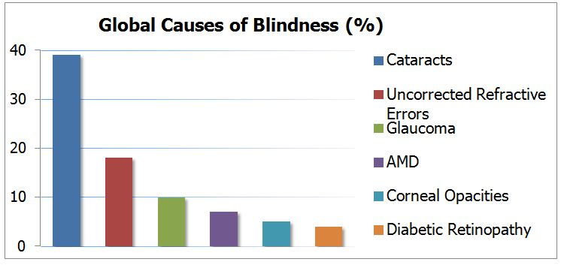
Causes of Preventable Blindness
LMST

Slide 14
Contribution of LMST in preventing blindness
LMST
Perform at more than 1000 cataract (pahco) surgeries per year free of cost
Provide free medicines for treatment of other causes of blindness such as glaucoma, Trachoma etc.
Provide free spectacles to needy patients.

Slide 15
Causes of Preventable Blindness
LMST
Blindness due to cataract is decreasing because treatment is cheap and easily available at least in the cities as is available at LMST.
Blindness due to Diabetes and Corneal Opacities is increasing day by day because
  Very few trained doctors
  Humnan Corneas not Available
  Equipment for treatment is very expensive
  Treatment cost is very high

Slide 16
Where LMST is lacking
LMST
No treatment facilities for diabetic patients which is a need of time.
Trained doctors are available but equipment is expensive and human corneas are not available.

Slide 17
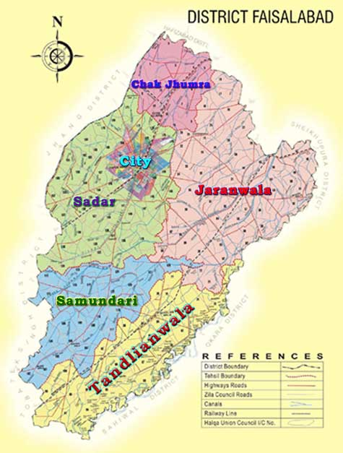
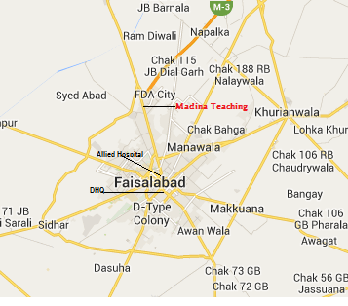
Target Population
LMST
3rd Largest City
Over 7 million Population
Only 2 complete eye hospitals

Slide 18
Why Treatment of diabetes induced blindness is important
LMST
Population involved is relatively of younger age group.
Those who are earning members of their families if go blind their dependents will also suffer.
If treated early a good vision can be preserved.
If left untreated all patients will eventually go blind.

Slide 19
Why Treatment of Corneal Opacity is Important
LMST
Blindness due to corneal opacity can be easily treated by Corneal transplant.
Young people who are blind just because of corneal opacity if treated can become useful members of society.

Slide 20
What we need to prevent blindness form diabetes
LMST
Fundus camera (FFA) and OCT machine costing PKR 8 million
Argon LASER costing PKR 4 million
Land and building for the Trust as we fail to maintain sterile environment of a hospital in this rented property which is not in a good shape.

Slide 21
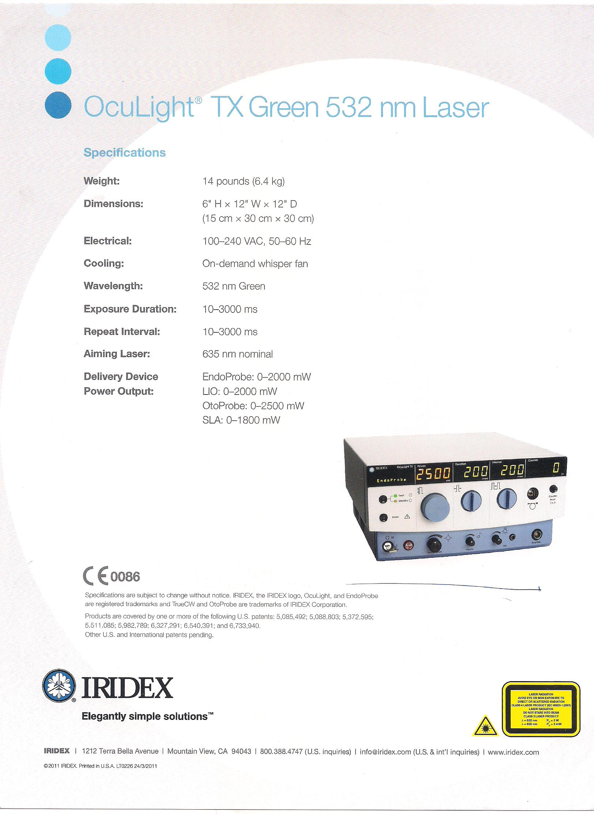
LMST

Slide 22
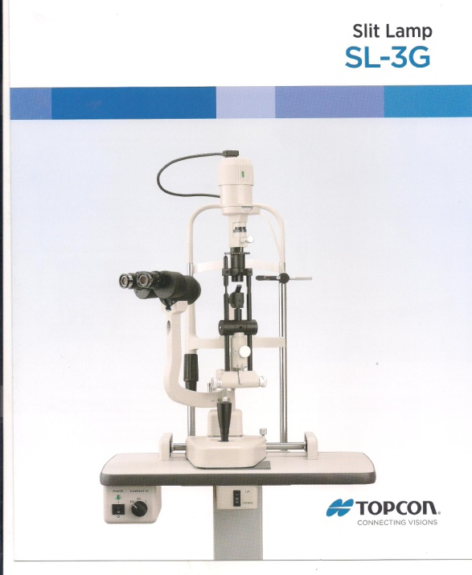
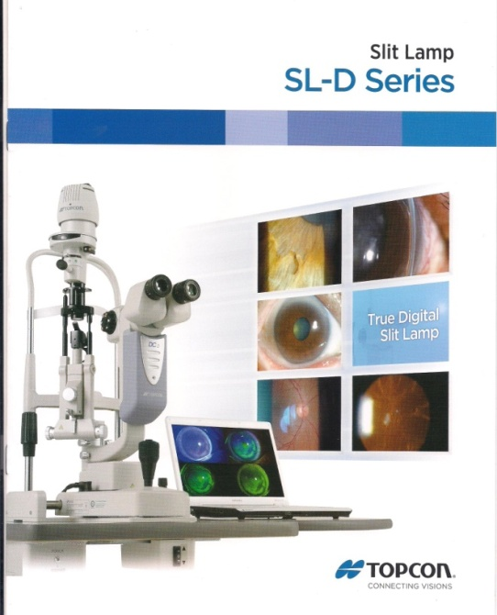
What we need to prevent blindness from corneal Opacities
LMST
Digital Slit Lamp costing PKR one million
Pachymeter for corneal thickness costing PKR 5 lac
B Scan costing one million.

Slide 23
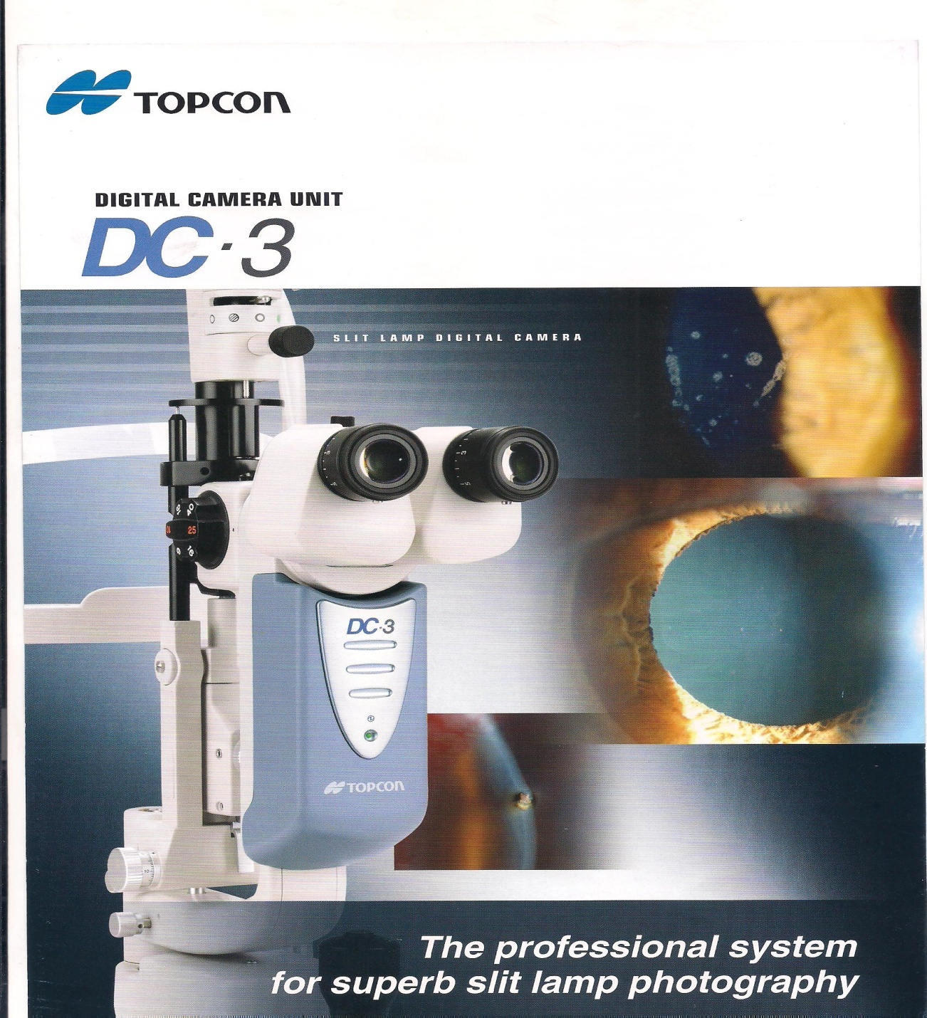
LMST

Slide 24
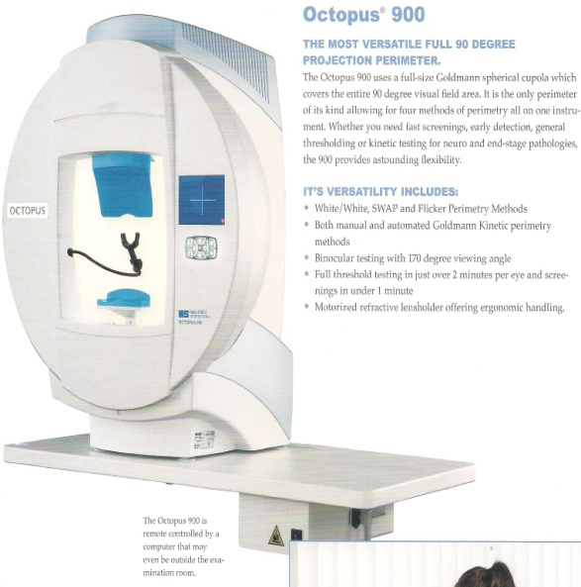
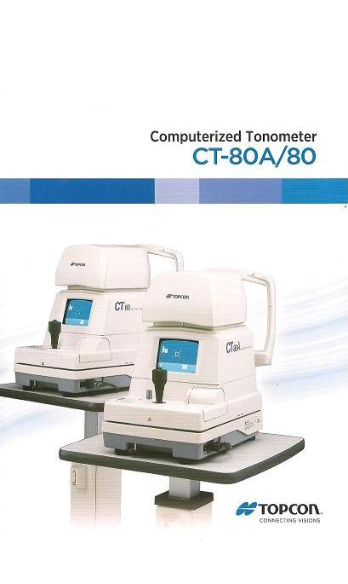
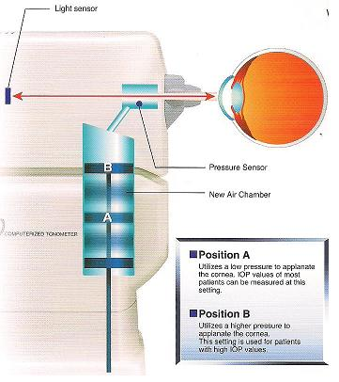
What we need to prevent blindness from corneal Opacities
LMST
Computerized Tonometer

Slide 25
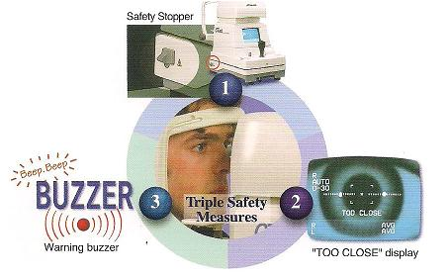
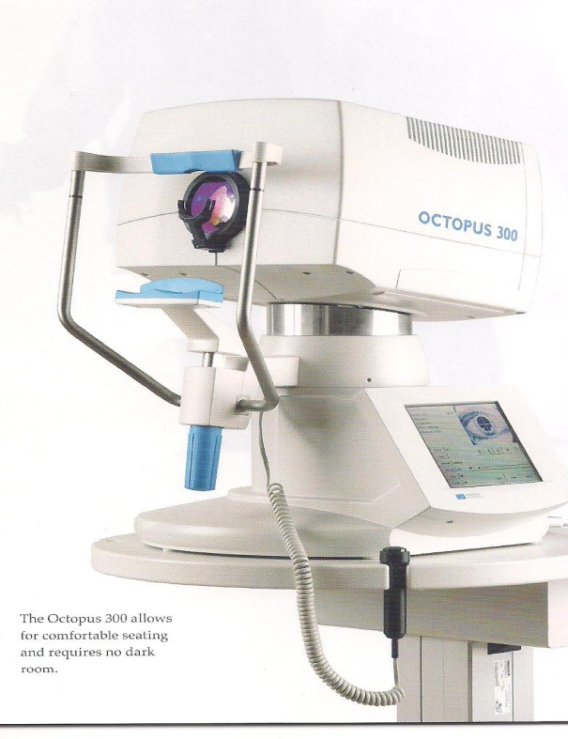
LMST

Slide 26
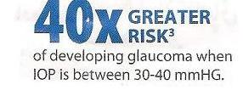
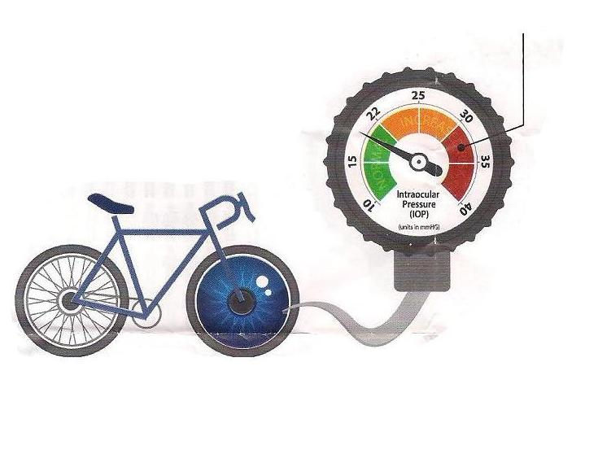
Patient Awareness of
GLAUCOMA EYE DISEASE
WHAT’S YOUR EYE PRESSURE?
What is glaucoma?
LMST
The eye and a bicycle tire have one thing in common . Both require the right amount of internal pressure for safety and performance. Glaucoma is a group of eye diseases associated with increased fluid pressure within the eye , and can cause irreversible loss of vision and eventually blindness untreated.

Slide 27
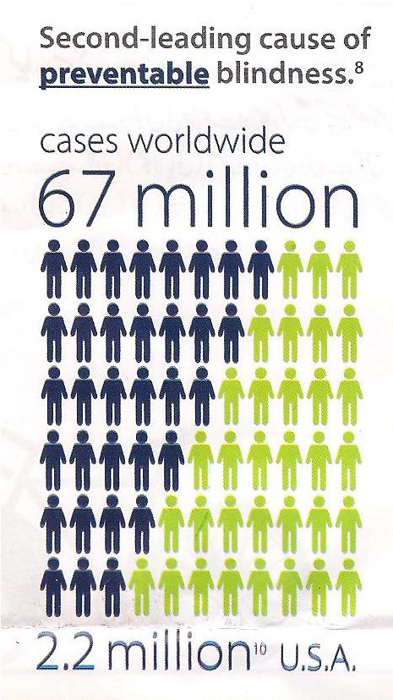
LMST

Slide 28
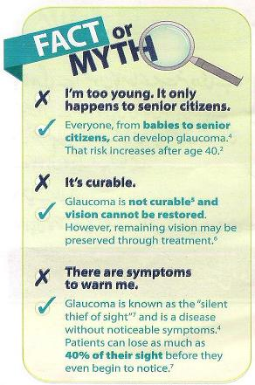
LMST

Slide 29
Thank you
www.lmst.org.pk

